Slide 1

Sinhgad College of Engineering, Pune – 41.
Department of Electronics &Telecommunication Engineering
“Gas Detection and Accident Prevention System”
by
Name –
Tushar Joshi
Suhas Khobragade
Omkar Bhise
Seat no –
T190233251
T190233145
T190233232
Guide Prof .
Dr. S. A. Shirsat
05/04/2022
Sinhgad College of Engineering, Pune – 41.
Department of Electronics &Telecommunication Engineering

Slide 2
CONTENTS
Introduction
Problem Statement
Objective
Literature Survey
Block Diagram
Selection Criterion of Components
Design Specifications and Calculations
Flowchart/Algorithm
Simulation and Testing
PCB Designing
Demonstration and Results
Conclusion
Future Scope
REFERENCES
05/04/2022
Sinhgad College of Engineering, Pune – 41.
Department of Electronics &Telecommunication Engineering

Slide 3
Introduction
Gas leakages are a common problem in households and industries. If not detected and corrected at the right time, they can be deadly. Unlike traditional gas-leakage alarms, our solution detects a leakage and shuts off power and gas to stop it from spreading. Two main parts make up this circuit: the sensor unit and the microcontroller unit. The sensor unit uses a gas sensor to detect dangerous or flammable gases like natural gas, LPG, or coal gas. It can also be used to sense other gases like iso-butane, propane, or even cigarette smoke. This unit is easy to incorporate into an alarm system.
Sinhgad College of Engineering, Pune – 41.
Department of Electronics &Telecommunication Engineering

Slide 4
Problem Statement
“Due to the large use of LPG gas cylinders in homes for cooking and heating water, it can be said that LPG gas is an integral part of many people's lives. However, there have been cases in the past about accidents due to gas leakage. The purpose of this project is to provide a security system to prevent accidents caused by gas leakage.”
05/04/2022
Sinhgad College of Engineering, Pune – 41.
Department of Electronics &Telecommunication Engineering

Slide 5
Objective
“Gas leaks in the home can present a serious threat to the safety of family members and pets. Leaks usually occur at locations such as the cylinder where the gas pipe is attached, or at cracks in a pipe leading to the appliance. An accident occurs when a spark occurs in an area where this leaked gas is present. Our project aims to detect such gas leaks and notifies homeowners and cuts off the gas supply. We also remove the gas from rooms where gas leakage has occurred.”
05/04/2022
Sinhgad College of Engineering, Pune – 41.
Department of Electronics &Telecommunication Engineering

Slide 6
Literature Survey
Sr. No | Authors | Proposed Method | Advantages | Disadvantages
1. | Anshuman Gupta Prakash , Dr. Lovi Raj Singh, Dr. Rajesh Gehlot, Dr. Anita Beri A Wireless Home Safety Gas Leakage Detection System | The goal of this book is to explore and illustrate the programming and interfacing of Arduino with gas sensors and detect the leakage. | This system includes Global positioning system so that user can collect the data along with position which can be used to study the air quality index of different locations | High Cost
2. | Rahul Gupta, Shubham Meena, Salman Khan, Raghunandan Garg, Rahul joshi. GSM Based Gas Leakage Detection System | In this research paper authors have proposed the leakage detection and real time gas monitoring system. In this system, the gas leakage is detected and controlled by means of turn of the power supply and gas valve | In this project, after the leakage of gas is detected, the valve is automatically closed, thereby stopping the leakage | Proposed System Consumes More Power
Sinhgad College of Engineering, Pune – 41.
Department of Electronics &Telecommunication Engineering

Slide 7
Literature Survey(2/2)
Sr. No | Authors | Proposed Method | Advantages | Disadvantages
3. | Luay Fraiwan, Khaldon Lweesy, Aya Bani-Salma, Nour Mani A Wireless Home Safety Gas Leakage Detection System | This paper represents a prototype for wireless gas leakage systems that can be used mainly in household safety and many other applications in the industry and environment | The use of a sensor that is sensitive to small changes of concentration provides an excellent tool to detect a gas leak as it can detect small concentrations down to 100 ppm. | The sensor used in the system may be affected by the surrounding temperature and humidity
4. | Ankit Sood, Babalu Sonkar, Atul Ranjan and Mr. Ameer Faisal Microcontroller Based LPG Gas Leakage Detector Using GSM Module ” by Ankit Sood, Babalu Sonkar, Atul Ranjan and Mr. Ameer Faisal | This paper presents a research work which is easy to use and gives remote indication to the user. The sensor used in this Research Work has excellent sensitivity combined with a quick fast response time. The system is highly reliable, tamper-proof and secure | In the long run the maintenance cost is very less | Relatively less accuracy
Sinhgad College of Engineering, Pune – 41.
Department of Electronics &Telecommunication Engineering

Slide 8
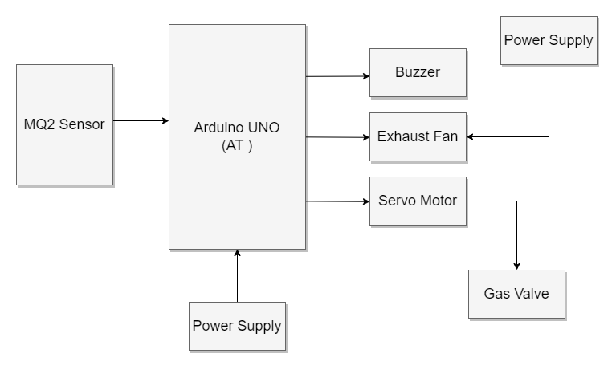
Block Diagram
05/04/2022
Sinhgad College of Engineering, Pune – 41.
Department of Electronics &Telecommunication Engineering

Slide 9
Selection Criterion of Components
Sr no. | Components Name | Description | Quantity
1. | Arduino Board | Arduino UNO R3 Development Board | 1
2. | Gas Sensor | MQ2 | 1
3. | Buzzer | JHD162A 16X2 LCD Display | 1
4. | Servo Motor | MG995 | 1
5. | DC Fan | Jumper Wires | 10
6 | Breadboard | - | 1
05/04/2022
Sinhgad College of Engineering, Pune – 41.
Department of Electronics &Telecommunication Engineering

Slide 10
Design Specifications and Calculations
05/04/2022
Sinhgad College of Engineering, Pune – 41.
Department of Electronics &Telecommunication Engineering

Slide 11
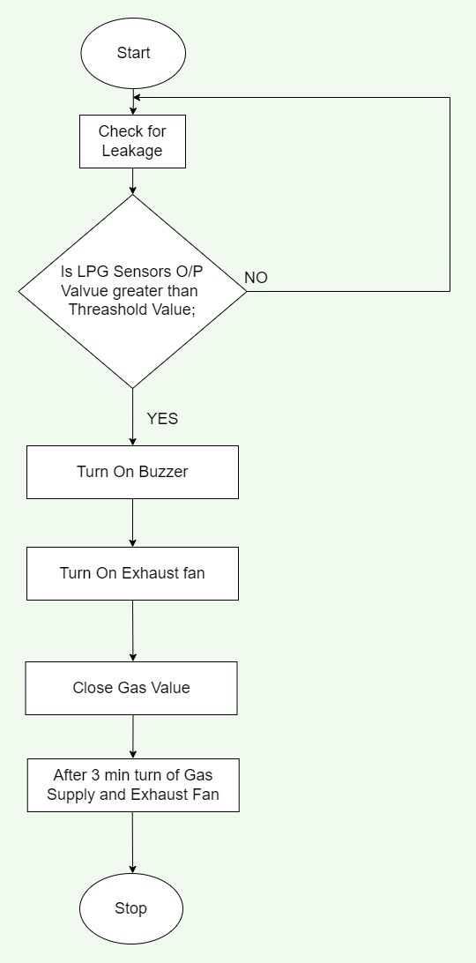
Flowchart/Algorithm
Algorithm :
Power ON the system.
05/04/2022
Sinhgad College of Engineering, Pune – 41.
Department of Electronics &Telecommunication Engineering

Slide 12
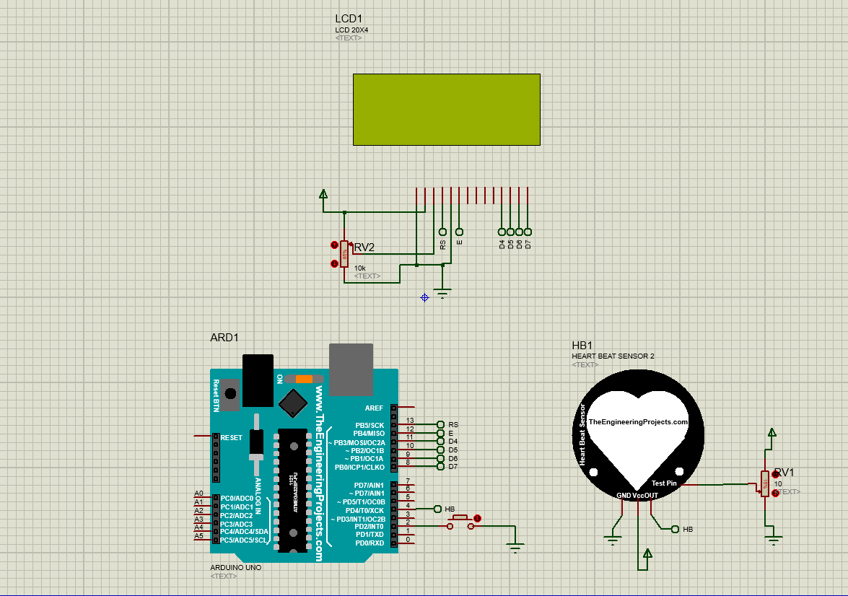
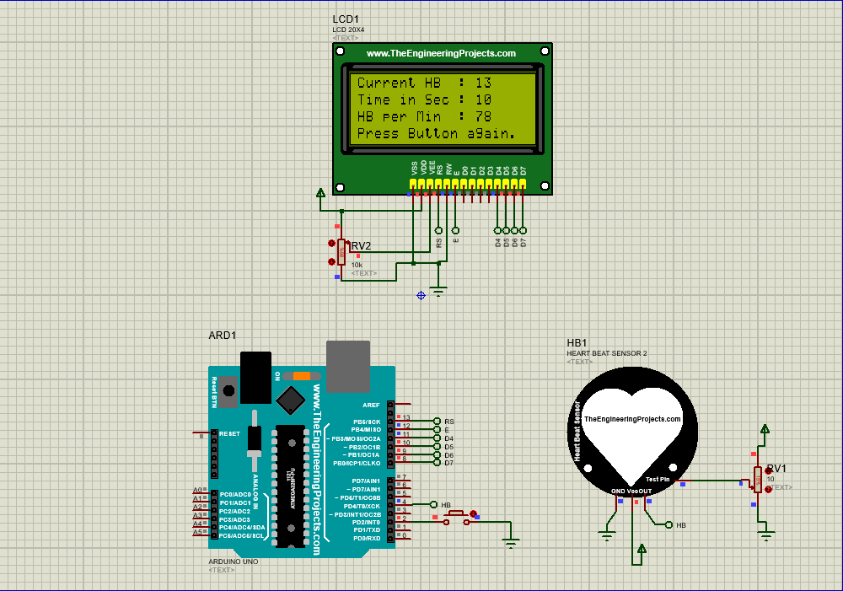
Simulation and Testing
Before
After
Sinhgad College of Engineering, Pune – 41.
Department of Electronics &Telecommunication Engineering

Slide 13
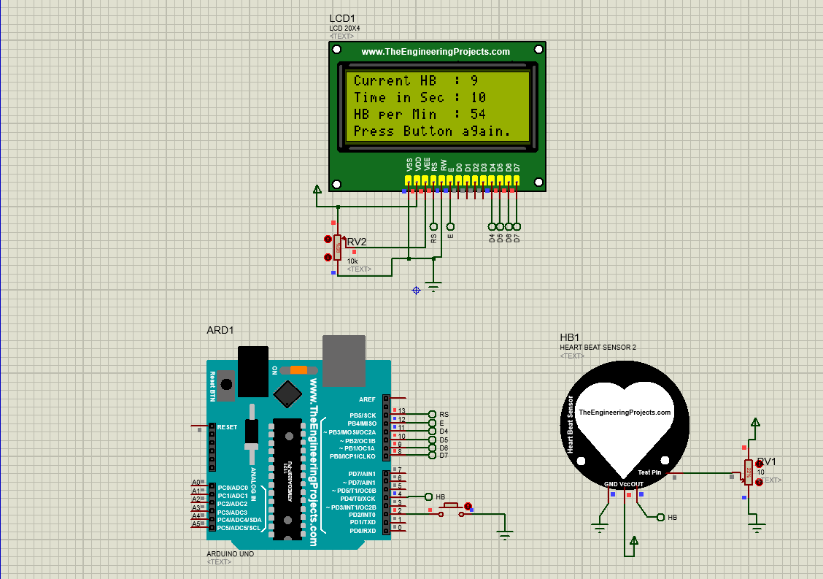


Results(4/5)
Test Result
05/04/2022
Sinhgad College of Engineering, Pune – 41.
Department of Electronics &Telecommunication Engineering

Slide 14
Applications
Home and Restorents
Consumes very low power (operates from 1.8V and 3.3V)
Ultra-Low Shutdown Current (0.7µA, type)
Fast Data Output Capability
05/04/2022
Sinhgad College of Engineering, Pune – 41.
Department of Electronics &Telecommunication Engineering

Slide 15
Conclusions
“This system provides a fast, cost-effective solution to prevent gas leak repercussions by reducing the risk of explosion and fire. It can collect gas leaks directly at the source and prevent them from reaching dangerous concentrations. The statistics of concentration of gas collected on the application can be useful in detecting faulty valves and regulators before replacement is required. A two-level prevention mechanism makes this system more reliable than others. The cost involved in developing this system is significantly low.”
05/04/2022
Sinhgad College of Engineering, Pune – 41.
Department of Electronics &Telecommunication Engineering

Slide 16
Future Scope
Gas Detection and Accident Prevention System can be further enhanced by using GSM to send the alert messages to user, which supports another real-time application. Form industrial sector, the data collected by the mobile application is beneficiary and used for data analytics. The integration of other sensors like temperature, pressure sensors etc. makes the system as a home automation project.
05/04/2022
Sinhgad College of Engineering, Pune – 41.
Department of Electronics &Telecommunication Engineering

Slide 17
REFERENCES
1.GSM Based Gas Leakage Detection System [Ashish Shrivastava, Ratnesh
Prabhaker, Rajeev Kumar and Rahul Varma.](International Journal of Emerging Trends in Electrical and Electronics (IJETEE – ISSN: 2320-9569))
Pereira, M., Kamath, N.K.: A novel IoT based health monitoring system using LPC2129. In: IEEE International Conference on Recent Trends in Electronics Information & Communication Technology, pp. 564-568 (2017)
Rouse, M.: What is RESTful API? https://searchmicroservices.techtarget.com/definition/RECTfolLAPT Aerceceed 24 Tune 9012xx
Hou, H., Xu, Y., Yan, H., Mubeen S., Zhang, H.: An elderly health care system using wire-less sensor networks at home. In: 3rd International Conference on Sensor Technologies and Applications, pp. 158-163 (2009)
05/04/2022
Sinhgad College of Engineering, Pune – 41.
Department of Electronics &Telecommunication Engineering

Slide 18
Thank You !!
Sinhgad College of Engineering, Pune – 41.
Department of Electronics &Telecommunication Engineering

